Slide 1
Project documentation
1)Project objective:
Identifying contaminants: Determine the presence and levels of various pollutants, such as heavy metals, bacteria, or chemicals, in the water.
Health assessment: Evaluate the potential health risks associated with the water quality to ensure it meets regulatory standards.
2) Design thinking process:

Slide 2
Empathize:
Understand the needs and concerns of the community or stakeholders who rely on the water source.Gather information about the current water quality issues and the impact on people and the environment .
Conduct interviews, surveys, and observations to gain insights into the specific challenges and goals
Define:
Clearly define the problem related to water quality based on the information gathered during the empathy phase.Create a problem statement that identifies the key issues to be addressed.

Slide 3
3) Development process
Project Initiation
Define the project's scope, objectives, and goals.Establish a project team with relevant expertise, including hydrologists, chemists, biologists, and environmental engineers.Determine the project's budget, timeline, and available resources.Data Collection and Sampling:Identify the water sources to be analyzed and sampled.
These may include rivers, lakes, groundwater, or drinking water supplies.Develop a comprehensive sampling plan, including the selection of sampling locations and frequencies.Collect water samples using appropriate techniques and containers to ensure data accuracy.

Slide 4
WATER QUALITY ANALYSIS
Abstract
Water quality analysis is a critical component of environmental monitoring and management. This abstract provides an overview of the key aspects of water quality analysis, including its significance, methodologies, parameters, and applications.
• It highlights the importance of monitoring water quality to safeguard human health, protect aquatic ecosystems, and support sustainable water resource management.
• The abstract also discusses common water quality parameters such as pH, turbidity, dissolved oxygen, and pollutant concentrations, detailing their role in assessing water quality.
• Additionally, it touches upon the diverse applications of water quality analysis, encompassing drinking water safety, wastewater treatment, industrial processes, and ecological studies.
• The abstract underscores the need for ongoing research and advancements in water quality analysis to address emerging challenges and ensure the availability of clean and safe water resources for future generation

Slide 5
CLARIFICATION AND PRE-FILTERATION
•When handling and processing wastewater and sewage, pre-filtration is very often a necessary stage in sample preparation to reduce fowling and improve the efficacy of downstream microfiltration.
• To designate pre-filtration, methods will sometimes call for “filter paper”, “coarse filter paper”, or simply indicate “filtration” in an early clarifying or particle-removing step.
• Pre-filtration requires an open mesh or net filter and can best be accomplished using options such glass fiber filters or quartz fiber filters for aqueous samples, or polypropylene filters for solvent filtration.

Slide 6
GENERAL FILTERATION OF WASTE WATER SAMPLES
• Many EPA and EPA-recommended methods do not specify filter type. They may designate parameters or specifications such as a pore size or format (disc or syringe filter) without detailing the filter material.
• Hydrophilic polyvinylidene fluoride (PVDF), polytetrafluoroethylene (PTFE), mixed cellulose esters (MCE), and cellulose acetate filters are all valid options for general filtration. Millipore® Durapore® PVDF and Omnipore™ PTFE filters are ideal for low-protein binding applications. Millex®-HA MCE syringe filters and MF-Millipore® MCE disc membranes are biologically inert, low binding, and thermally stable with a high loading capacity.
• All three membrane filters provide low extractable filtration for minimal contamination. LCR PTFE filters are specially treated to prevent the introduction of additional extractable to your sample prior to HPLC analysis or similar instrumentation

Slide 7
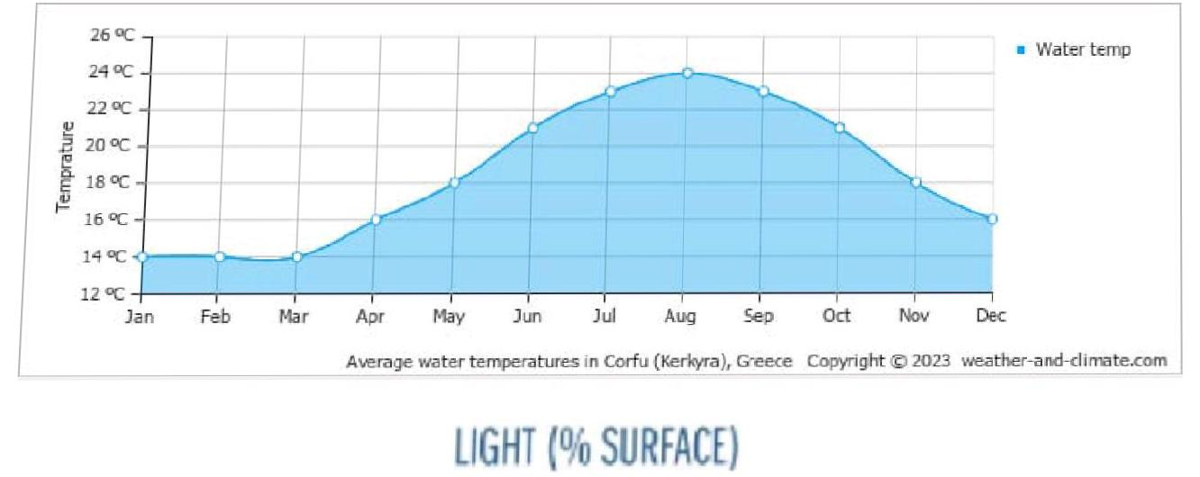
TESTING
• ASTM D2972- ARSENIC in water
• CTD (Conductivity temperature dept)
• 5510 AQUATIC human substances

Slide 8
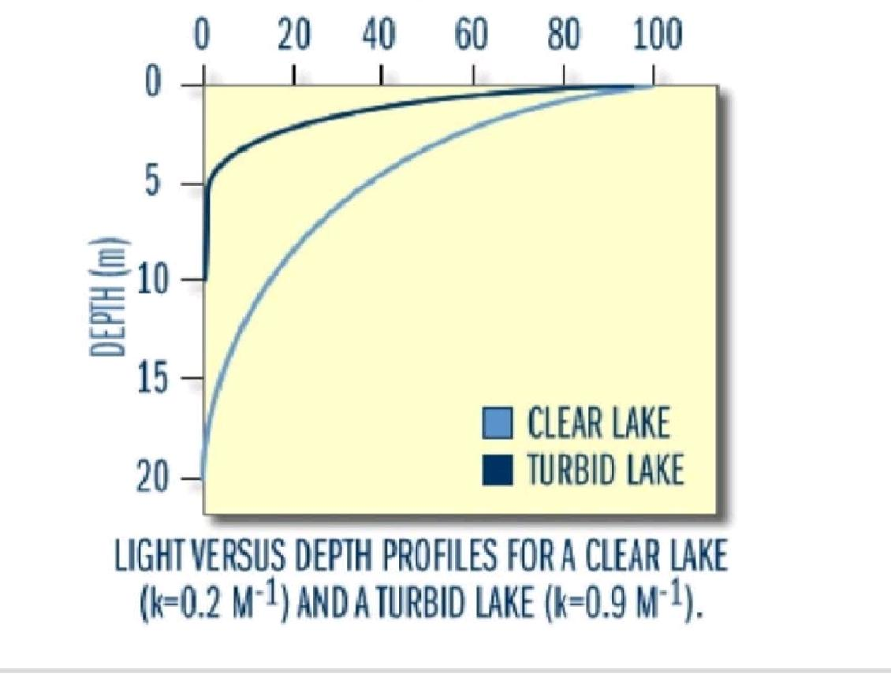

Slide 9
Algorithm used in water quality analysis
Algorithm used in water quality analysis
Calculating the WQI is time-consuming, but estimating WQI is inevitable for water resources management. For this purpose, three Machine Learning (ML) algorithms, namely, Gene Expression Programming (GEP), MSP Model tree, and Multivariate Adaptive Regression Splines (MARS), were employed to predict WQI.

Slide 10
Innovation steps
• Introduction: Provide background information on the purpose of the water quality analysis and its significance. Data Collection: Detail the sources of your data, including the locations and frequency of sampling.Parameters Analyzed: List the specific water quality parameters assessed, such as pH dissolved oxygen, turbidity, etc.WOI Calculation: Explain how you calculated the Water Quality Index using the chosen algorithm. For example, WOI calculation often involves assigning weights and ratings to different parameters, Interpretation Discuss the interpretation of the calculated WQI values. Explain what the values indicate about theoverall water quality.. Results and Findings: Present the WQI values for each sample or location, and highlight any trends or patternsobserved. Comparison: If applicable, compare the WQI values to relevant water quality standards or guidelines set by regulatory agencies.Recommendations: Based on your findings, suggest any necessary actions or interventions to improve water quality.Limitations. Acknowledge any limitations in the analysis, such as data gaps, assumptions, or potential sources oferror. Conclusion: Summarize the key findings and their implications for water quality managementReferences: Include a list of sources and references used in the analysis.

Slide 11
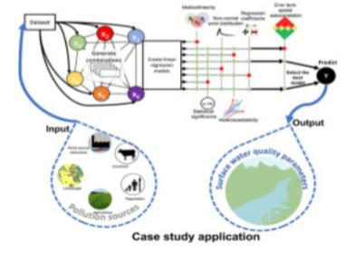
Case study applicationMethod

Slide 12
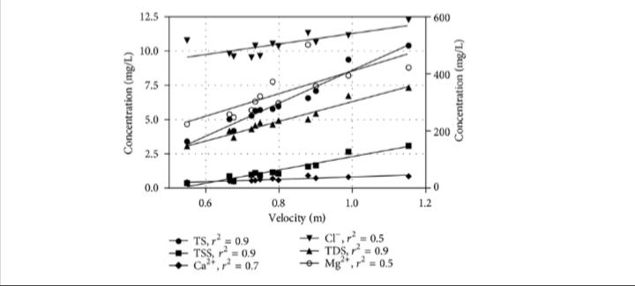
Graphical representation

Slide 13
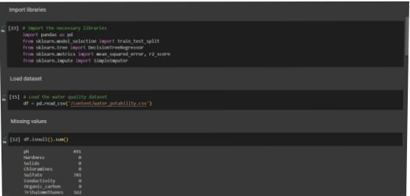
TITLE: WATER QUALITY ANALYSIS USING m5p ALGORITHM
HERE, I USED TO START BUILDING THE WATER QUALITY ANALYSIS BY PRE-PROCESSING THE DATA AND PERFORMING USING EDA WITH m5p ALGORITHM.WITH THAT I TO OBTAIN THE WATER QUALITY DATASET AND PRE-PROCESS IT BY HANDLING MISSING VALUES AND OUTLIERS.TO CONDUCT EDA TO VISUALIZE PARAMETER DISTRIBUTIONS, CORRELATIONS AND POTENTIAL DEVIATIONS FROM STANDARDS.FIRST I IMPORT THE NECESSARY LIBRARIES

Slide 14
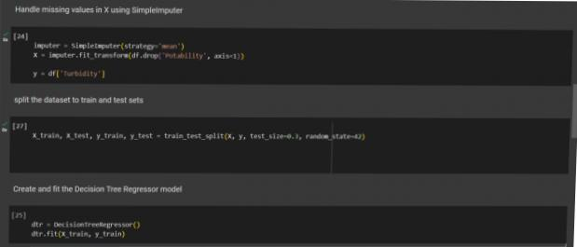
AFTER THAT I UPLOAD THE WATER POTABILITY CSV FILE.AND THEN CALLING THE MISSING VALUE FUNCTIONS.SPLIT THE DATASET TO TRAIN AND TEST.
HANDLE MISSING VALUES IN X USING SIMPLEIMPUTER.→ SPLIT THE DATASET TO TRAIN AND TEST SETS.

Slide 15
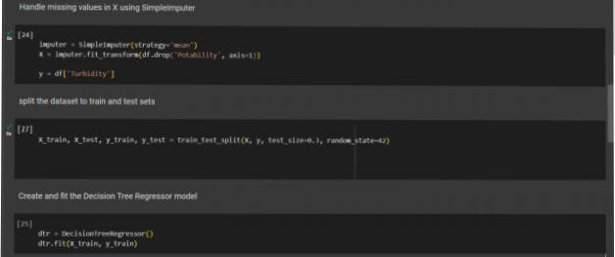
→AFTER THAT I UPLOAD THE WATER POTABILITY CSV FILEp
.→AND THEN CALLING THE MISSING VALUE FUNCTIONS.SPLIT THE DATASET TO TRAIN AND TEST.
HANDLE MISSING VALUES IN X USING SIMPLEIMPUTER.

Slide 16
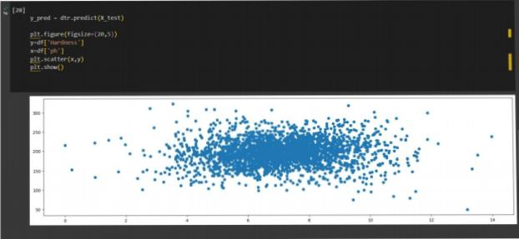
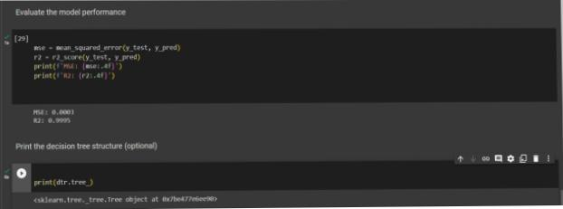
CREATE AND FIT THE DECISION TREE REGRESSOR MODEL.
TO PREDICT USING THE DTR(DECISION TREE REGRESSOR AND PLOT THE FIGURE(SCATTER PLOT).

Slide 17
EVALUATE THE MODEL PERFORMANCE TO FIND THE MSE(MEAN SQUARED ERROR) AND r2 SCORE
.FINALLY I PRINT THE DECISION TREE STRUCTURE WITH THE PYTHON CODE OF print(dtr.tree_)

Slide 18
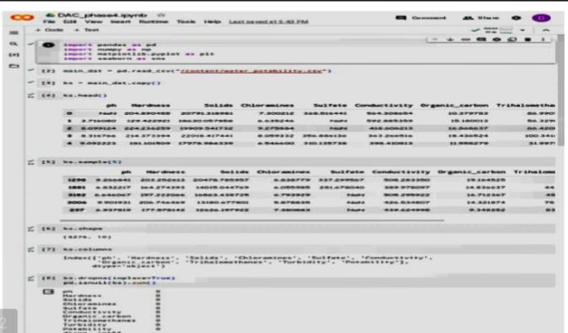

Slide 19
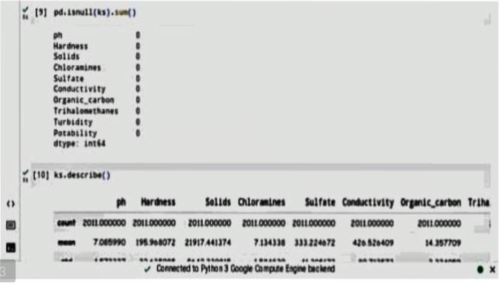

Slide 20
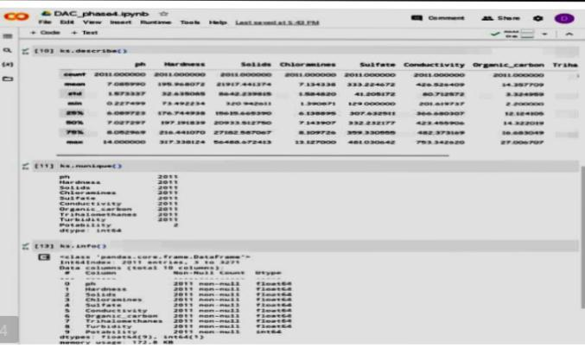

Slide 21
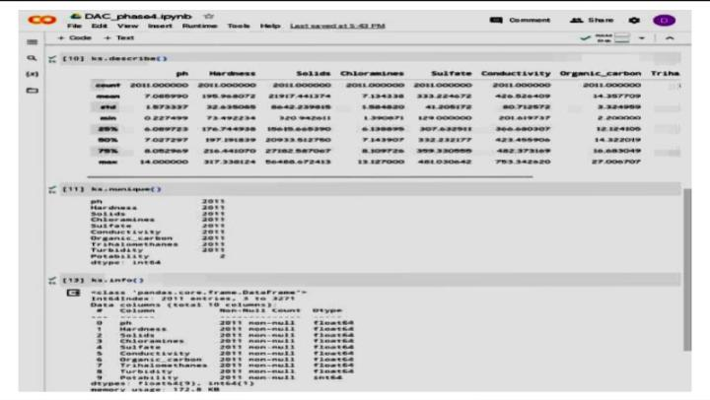

Slide 22
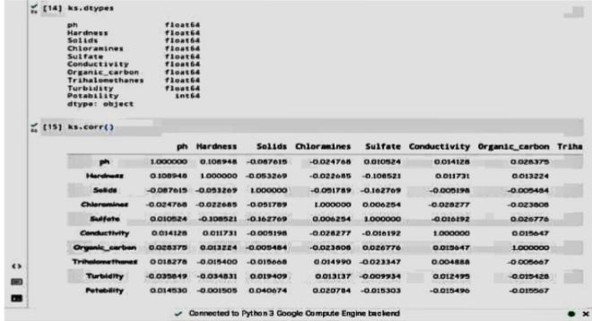

Slide 23
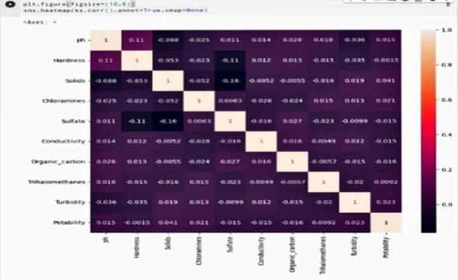

Slide 24
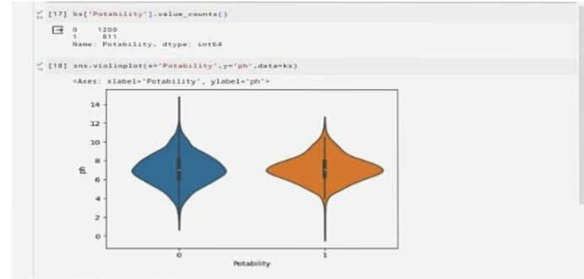

Slide 25
